Slide 1

Extracting boundaries in Soft X- Ray Images
Elise A. Donkor
Mentors: Dr. Brian Walsh and Dr. David Sibeck
Notes:
My project was about extracting boundaries in X - ray emission images from the magnetosphere.

Slide 2
Topics
Background - science and instrument
Previous methods
My method compared to previous methods

Slide 3
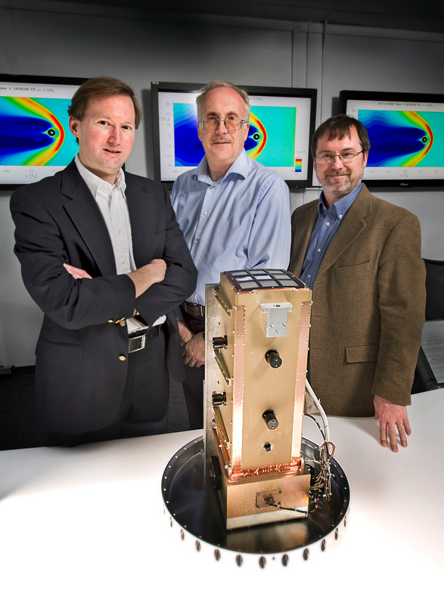
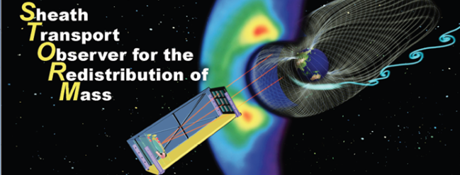
X - Ray imager
Studies charge exchange
Used to identify boundaries, layers and cusps
can provide information needed to improve space weather models

Slide 4
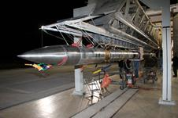
Black Brant IX rocket
Carried STORM (DXL) Diffuse X-ray emission from the Local galaxy
both instruments designed to study charge exchange
Working prototype was built
Launched in 2012

Slide 5
Charge Exchange
“A physical phenomenon that occurs when the solar wind collides with Earth's exosphere and neutral gas in interplanetary space” - NASA
Scientists first discovered the charge-exchange in the mid-1990s
Common phenomenon caused by the solar wind

Slide 6
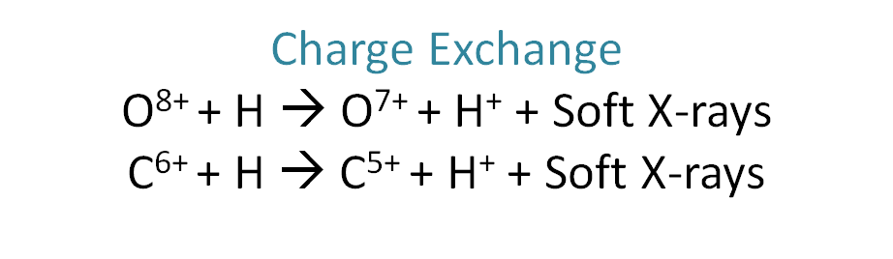
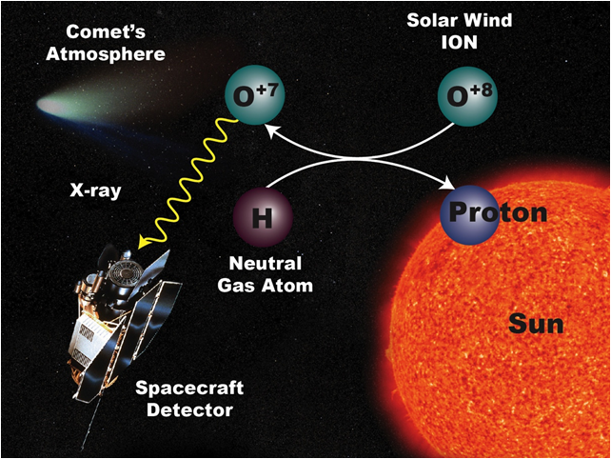
Ions from the solar wind collide with neutral atoms from the Earth’s magnetosphere
Produce X -rays
Satellite (STORM) detects the intensity of the X - rays

Slide 7
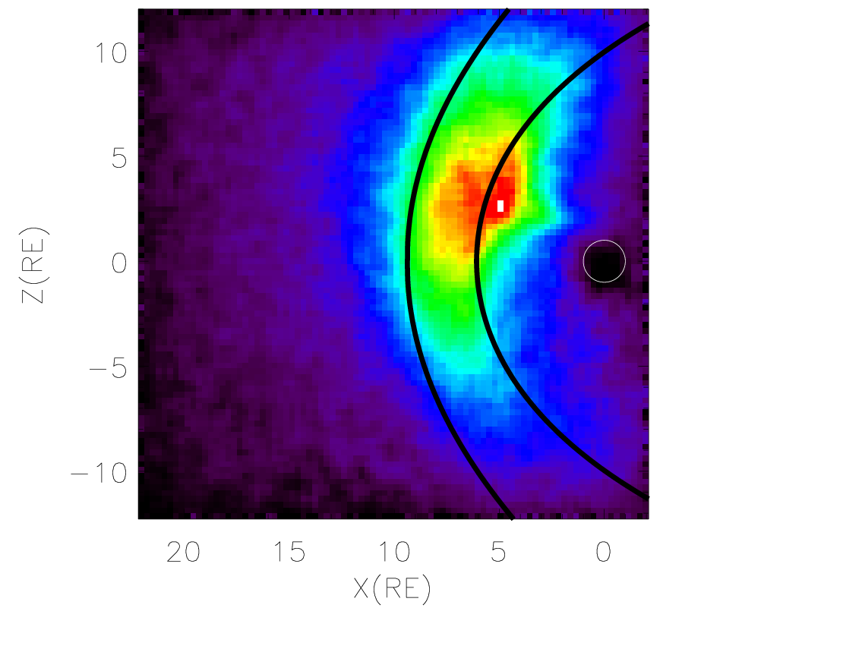
Previous Boundary Models
Bow Shock
Bennett et al JGR 1997
magnetopause
Shue et al. JGR 1998a
Identifies location
doesn’t show dynamic nature of the boundaries

Slide 8
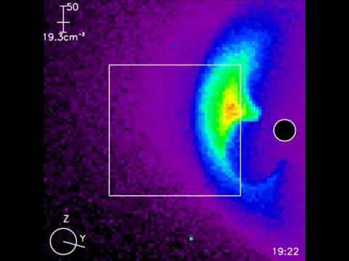
Simulations from STORM
Model efforts are underway for the charge emissions for STORM
Simulation of the predicted emissions from STORM.
The color shows intensity of the X-rays.
Shows strongest emissions in the magnetosheath

Slide 9
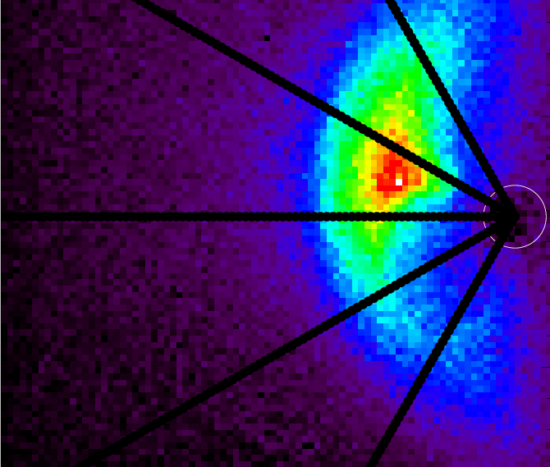
First step:
Make radial lines extending from the center of the earth
Derivative Model:
Plot the points on each line where there is a sudden increase and a sudden decrease in x - ray intensity

Slide 10
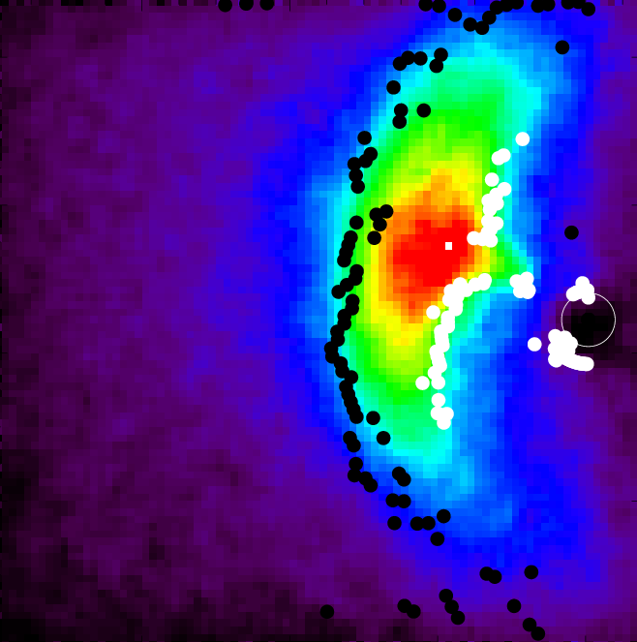
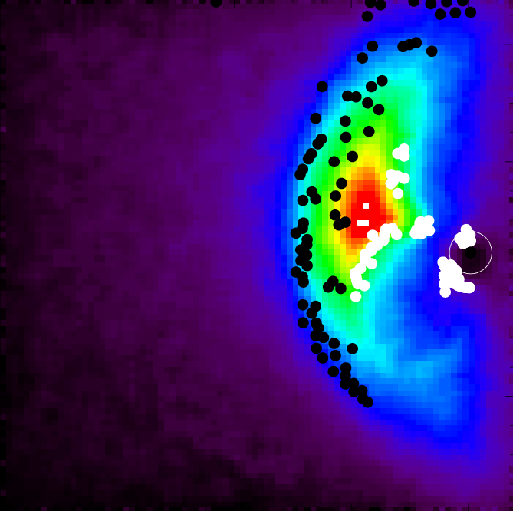
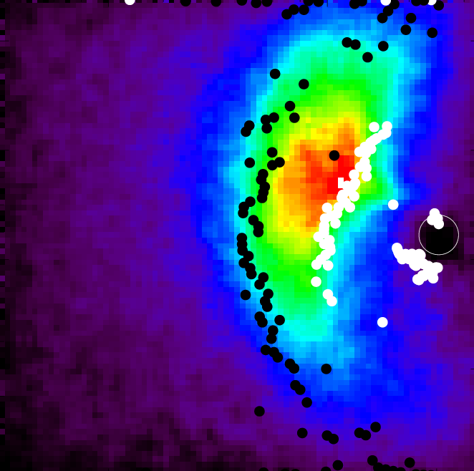
Derivative Model
Not a good model for the magnetopause
Decided to take location of satellite into account

Slide 11
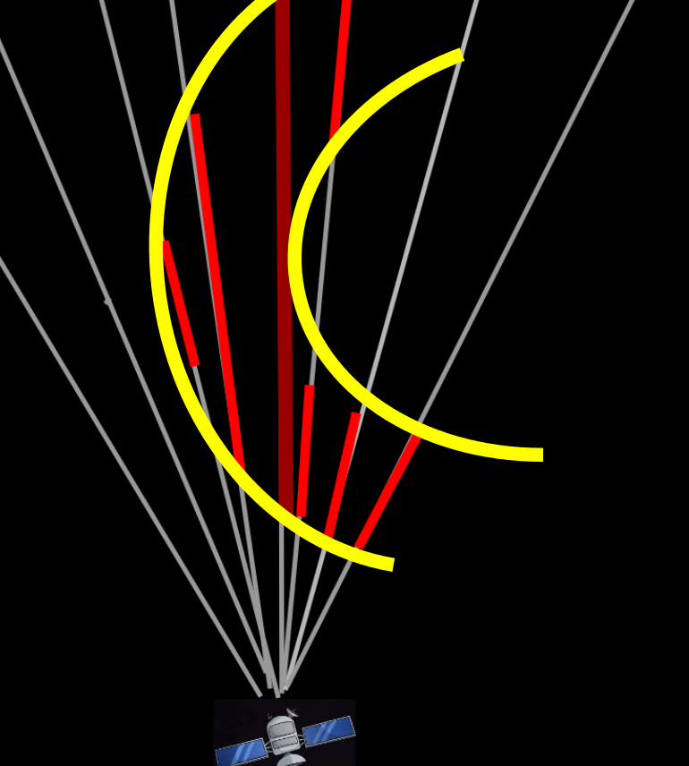
Bowshock
We know Intensity of X- ray emissions are greatest in between the bow shock and the magnetopause
Satellite displays X- ray intensity over each line of sight
Peak of X- Ray intensity (longest red line) at the location of the magnetopause
Magnetopause

Slide 12
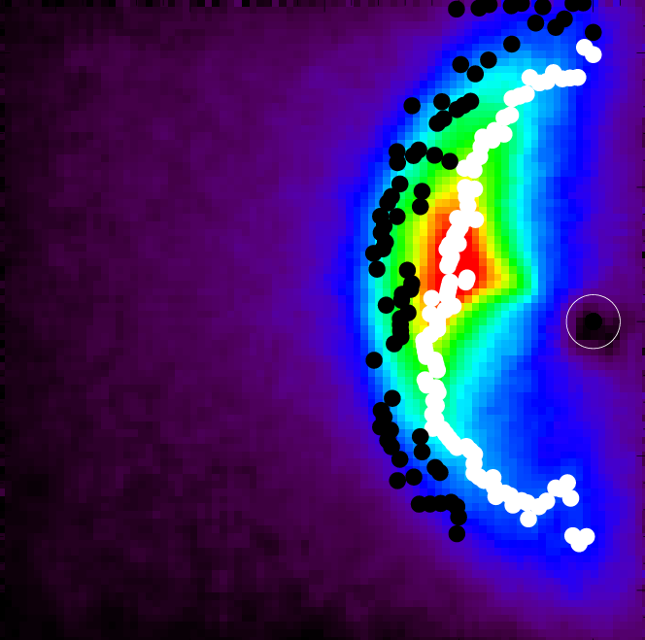
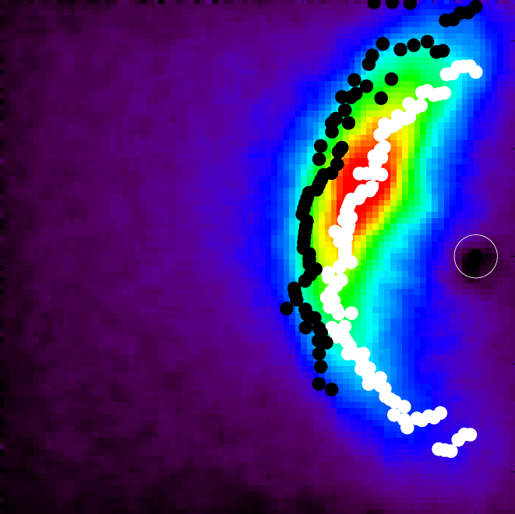
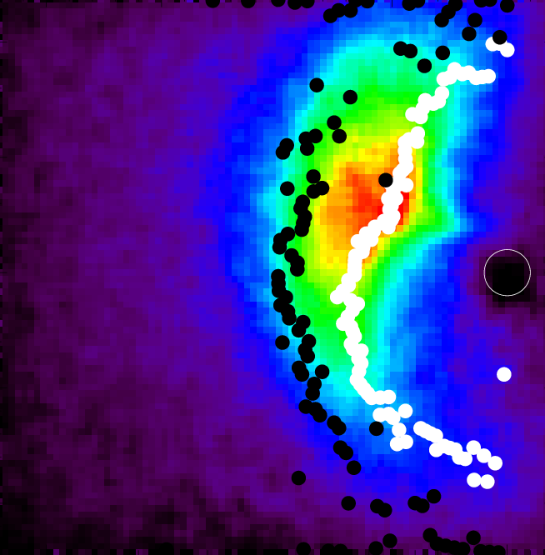
Peak Model

Slide 13

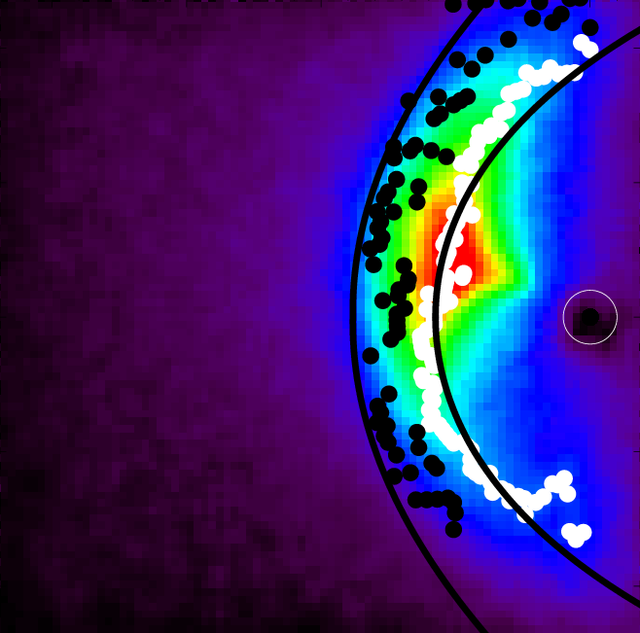
Compared to Bennett and Shue

Slide 14
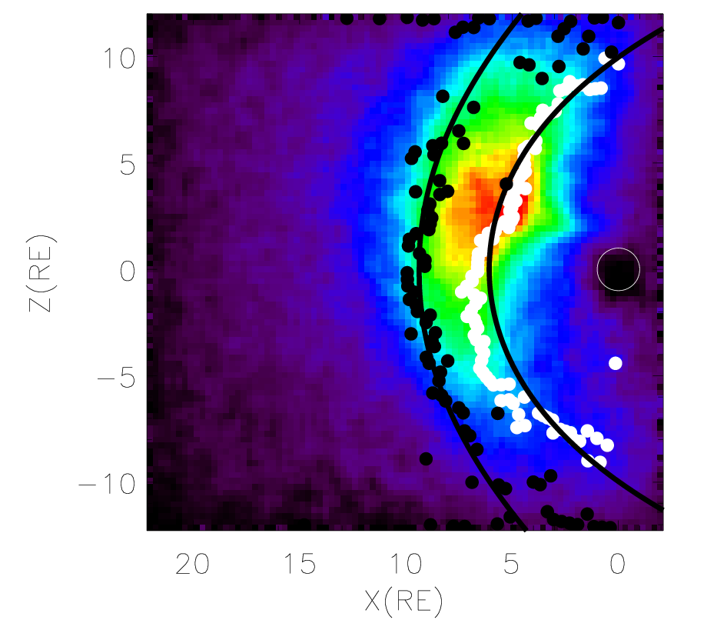
Conclusions
Derivative : bowshock
Peak : magnetopause
show variations in boundaries
Better models than Shue and Bennett

